Slide 1
Categorizing Investment Risk and Deducing Its Implications on Investor Decisions
Mrunal Ghadigaonkar
Sailee Shedge
Grishma Mehta
Alisha Mali
Prachit Phanse
A005
A006
A007
A008
A009

Slide 2
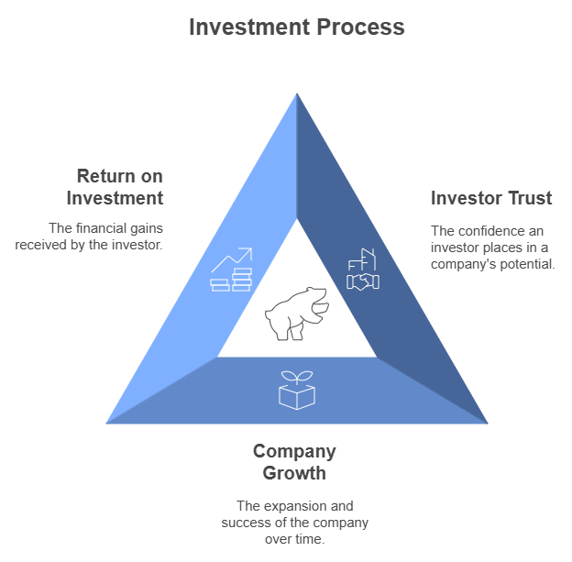

Slide 3
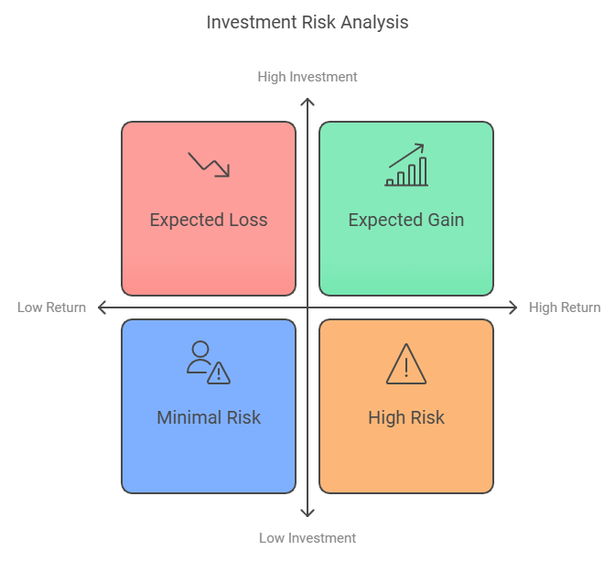
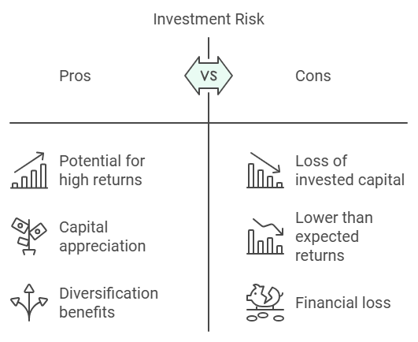

Slide 4
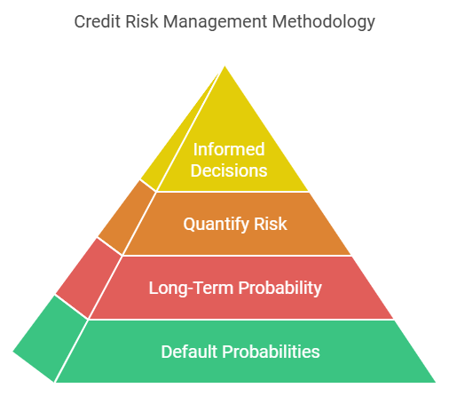
Business Objective
Research Objective
To create a comprehensive credit risk management methodology that enables investors classify companies into three broad risk categories, enabling them to make decisions that minimize their investment risk.
To classify companies based on their default probabilities and identify commonality between companies that provide us minimum risk sectors.
Determine the long run probability that any given investment ends up in a high risk situation of potential losses.
Quantify risk by identifying inflection points in a company’s performance.
Enable investors to make an informed decision as to when to pull out of an investment given speculations of a possible bearish market.

Slide 5
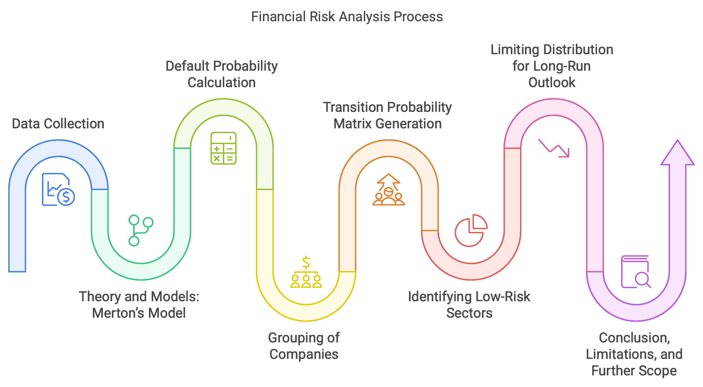
Outline

Slide 6
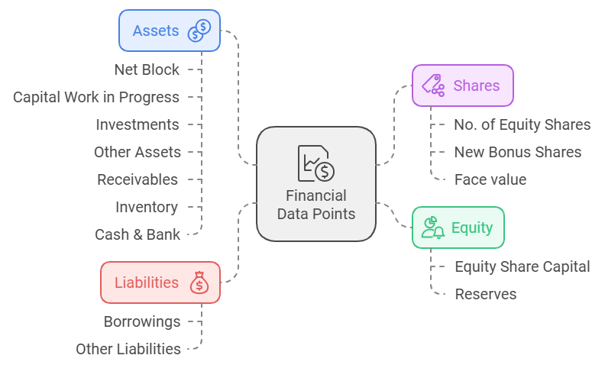
Data Description
Data Scope: Yearly financial data from 35 public companies across India.
Data Sources:
Screener.in
Investing.com
Financial data from 2017-2023.

Slide 7
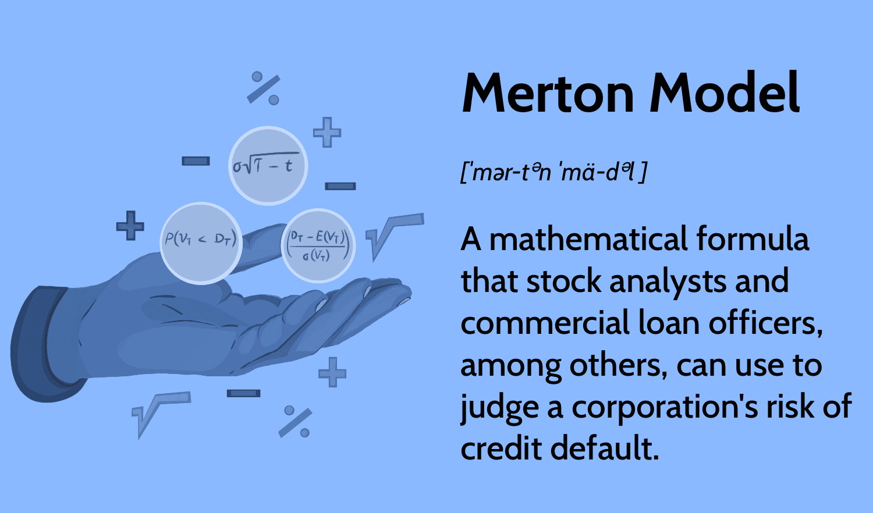
“Merton’s model uses a company’s cash flow volatility to estimate the probability of default by treating it as a stochastic process.”

Slide 8
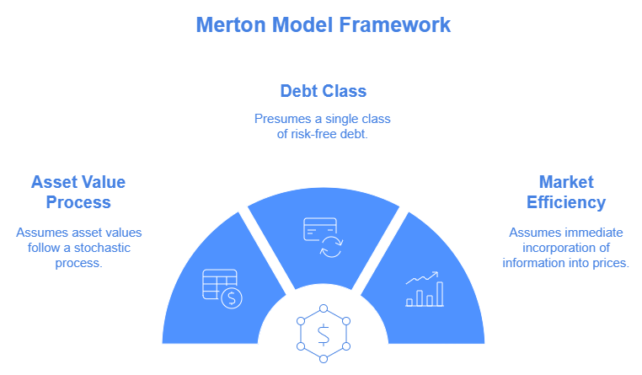
Assumptions
Market is assumed to be frictionless meaning that the value of the company’s asset is equal to the sum of the value of debt obligation and the value of the equity at date t.
Company cannot pay dividend or issue new debt until the maturity T.
Default occurs if the company is not able to pay debt holders at maturity.

Slide 9
Model Equation:
dV = Vdt + σVdz
This is the stochastic differential equation for the company’s operating cash flow.
Probability of Default:
P ( Vt < C|F ) = 1 - Φ(d2)
This equation gives the probability that the company's cash flow which will be less than the debt C, indicating a default.

Slide 10
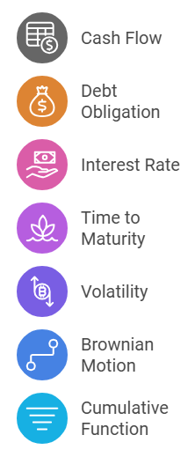
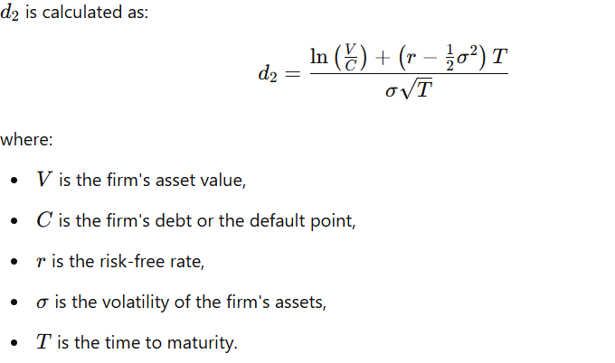
Present Value of Expected Cash Flow

Slide 11
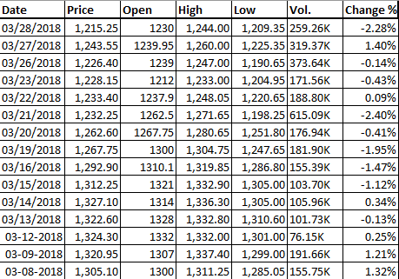
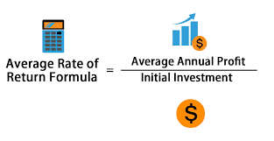
Volatility Calculations
Stock price data for PVR

Slide 12
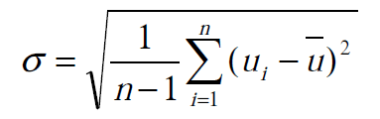
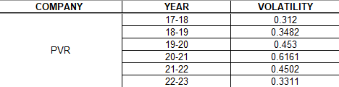
Computing Volatility using the formula below:

Slide 13
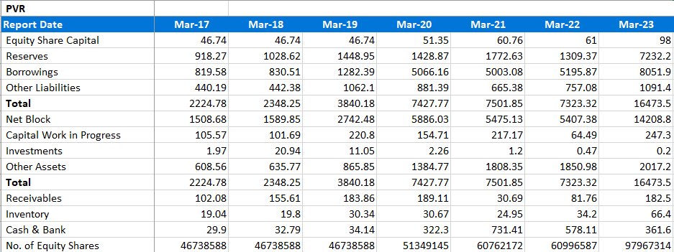
Default Probability Calculation
asset_value = netblock + CWIP+ Investments + otherassets + Receivables + Inventory + Cash
debt_value = Borrowings + other liabilities
The risk-free rate represents the return on an investment with zero risk, meaning no chance of default or loss of principal.
The India 10-Year Government Bond currently offers a yield of 6.770%

Slide 14
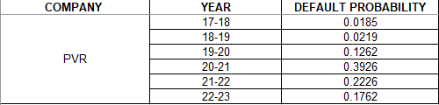
Output of Default Probability
Above procedure is applied to all 35 companies

Slide 15
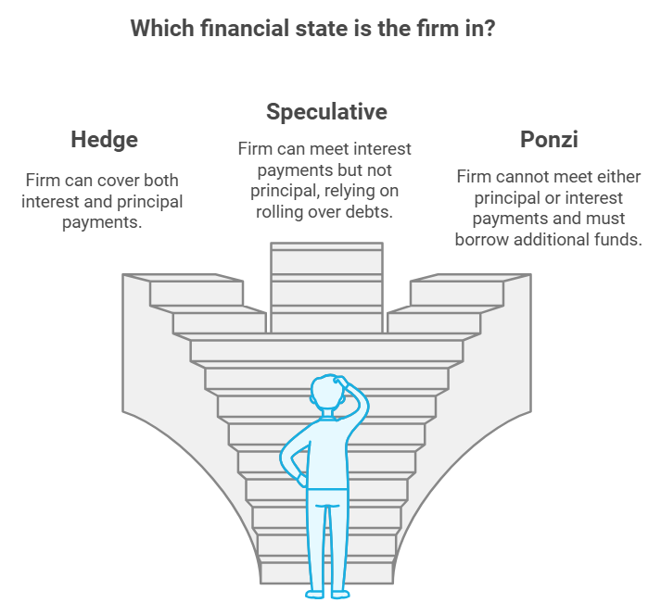
Minsky’s Hypothesis
“Minsky's Hypothesis states that firms evolve through three stages of financial stability based on their debt repayment abilities: Hedge, Speculative, and Ponzi finance.”

Slide 16
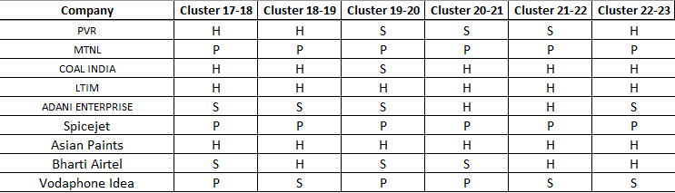
Categorizing Companies into 3 Groups
Hedge(H) Speculative(S) Ponzi(P)

Slide 17
Obtaining Inflection Points
States | Inflection Points
Hedge | 1.0507E-33 TO 0.1967
Speculative | 0.2694 TO 0.4804
Ponzi | 0.7813 TO 0.9575
In business, an inflection point refers to a time of significant change in a company or industry. It might signal the start of strong growth, decline, or a major strategic shift due to innovations, market trends, or economic changes.

Slide 18
Markov Chain
“The Markov Chain model is used to analyze changes in a debtor’s credit rating over time. In finance, this model helps assess the likelihood of a company transitioning between credit ratings based on historical data.”
Process
A Markov Chain represents a sequence of events where the probability of moving to a new state depends only on the current state, not the previous history.
This model uses transition probabilities to define how likely a company is to move between different credit ratings (e.g., from "A" to "B" rating).
Model Equation
P ( Xn+1= j| Xn= i , Xn-1= in-1 , ... , Xo= io) = P (Xn+1= j| Xn= i )
∀ i, j, i0, … ,in ∈ S , n ≥ 1

Slide 19
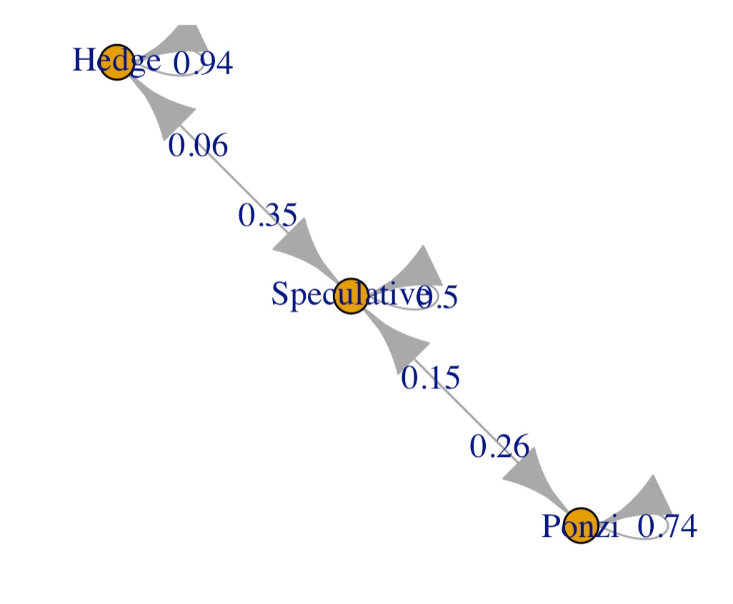
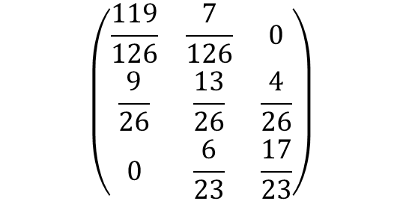
Transition Probability Matrix
H
S
P
The TPM indicates probability of migrating from one risk state to another over the course of 1 year.
H
$$\left(\begin{matrix}\frac{119}{126} & \frac{7}{126} & 0 \\ \frac{9}{26} & \frac{13}{26} & \frac{4}{26} \\ 0 & \frac{6}{23} & \frac{17}{23}\end{matrix}\right)$$
S
P
States | Long Run Probability
Hedge | 0.7967
Speculative | 0.1278
Ponzi | 0.0754
Long run probability indicates that irrespective of which state we start in we would have 7.5% chance of being in a high risk state.

Slide 20
Comparing Simulated and Empirical Transition Probabilities
Original TPM
Empirical TPM (Simulation)
States | Hedge | Speculative | Ponzi
Hedge | 0.94444444 | 0.05555556 | 0
Speculative | 0.34615385 | 0.5 | 0.15384615
Ponzi | 0 | 0.26086957 | 0.73913043
States | Hedge | Speculative | Ponzi
Hedge | 0.94513545 | 0.05486455 | 0
Speculative | 0.34935542 | 0.49782188 | 0.15282269
Ponzi | 0 | 0.26097447 | 0.73902553

Slide 21
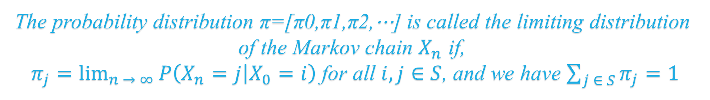
Limiting Distribution
The probability distribution π=[π0,π1,π2,⋯] is called the limiting distribution of the Markov chain $X_{n}$ if,
$π_{j}=\lim_{n → ∞}{P\left(X_{n}=j | X_{0}=i\right)}$ for all $i, j∈S$, and we have $\sum_{j ∈ S}^{ }{π_{j}}=1$
Hedge | Speculative | Ponzi
0.7967 | 0.1279 | 0.0754

Slide 22

Limitations
No consideration for liquidity constrains
Dependence on Financial Statements
Requirement of Market Data
04
03
05
Single-period Framework
02
Continuous Trading
06
01
07
Rotating cashflow
Small Sample size (35 Companies)

Slide 23




Conclusions
The TPM shows that a company in a hedge state won't jump directly to a high-risk (Ponzi) state but will move through an intermediate risk state. This allows investors time to assess and decide before withdrawing.
There's a 12% chance of ending up in high-risk investments, even when choosing companies in typically “safe” sectors, implying potential financial loss.
Inflection points indicate the threshold for acceptable risk. A 26% default probability is considered too high to qualify as "low risk.“
IT, Pharma, and Construction/Real estate companies, primarily in the Hedge category, are low-risk sectors, making them suitable for new investors.

Slide 24
References
Gavira-Durón, Nora, Octavio Gutierrez-Vargas, and Salvador Cruz-Aké. "Markov chain K-means cluster models and their use for companies’ credit quality and default probability estimation." Mathematics 9.8 (2021): 879.
https://www.investopedia.com/terms/m/mertonmodel.asp
https://www.screener.in/
https://www.investing.com/
https://www.ibm.com/topics/k-means-clustering

Slide 25
Thank You

